Slide 1
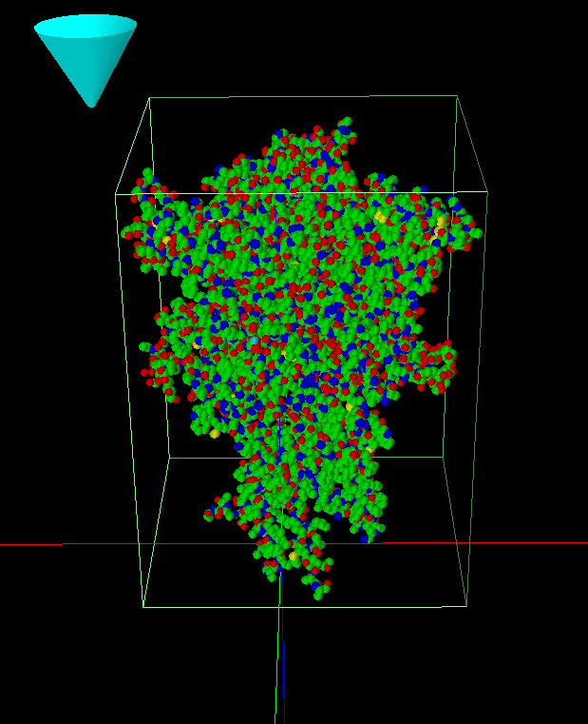
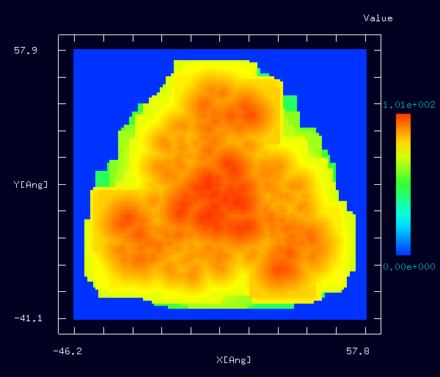
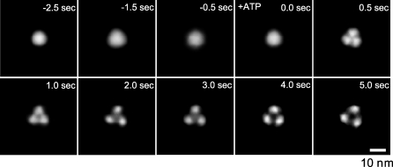
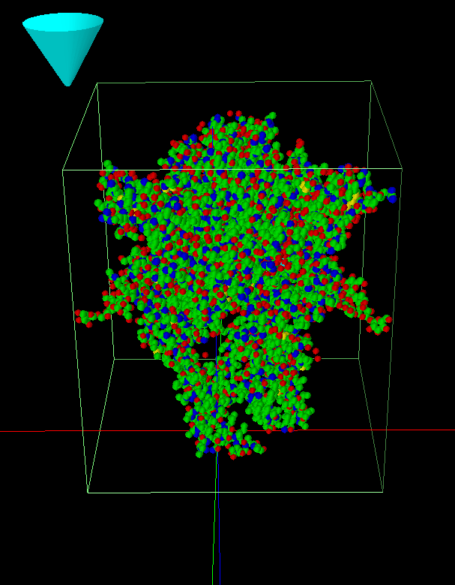
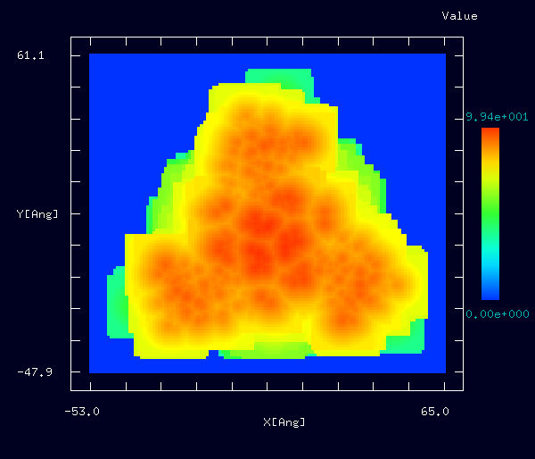
【GeoAFM】 P2X₄受容体のAFM 像
GeoAFM
P2X₄受容体は細胞表面のイオンチャネル型ATP受容体で、ATP存在下で構造が変化する。
Simulation
Experiment
Tip: Cone shape
Fast-Scanning AFM Observations of the ATP-Induced Structural Changes in the P2X4Rs.
GeoAFM result is imported to Analyzer.
Before activation
Before activation
Sample: P2X₄ receptor,
closed state (PDB: 4dw0)
obtuse triangular structure
After binding with ATP
Tip: Cone shape
Y. Shinozaki, K. Sumitomo, M. Tsuda, S. Koizumi, K. Inoue, K. Torimitsu, PLoS Biol., 5;7(5):e103, 2009.
After binding with ATP
GeoAFM result is imported to Analyzer.
Sample: P2X₄ receptor,
open state (PDB: 4dw1)
Trimer structure
Notes:
GeoAFM_CalcImage_Polymer_011a
GeoAFM_CalcImage_Polymer_011b
PDB: 4dw0. SPMシミュレータに読み込み、回転(a, b, g) = (0, 0, 60)度。
PDB: 4dw1. SPMシミュレータに読み込み、回転(a, b, g) = (180, 0, 15)度。
探針：Cone, 1Å, 30°
GeoAFM, resolution = 1Å

