Slide 1
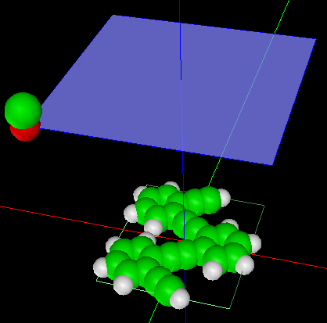
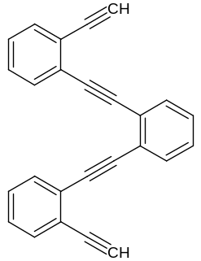
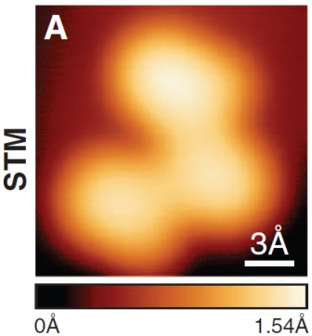
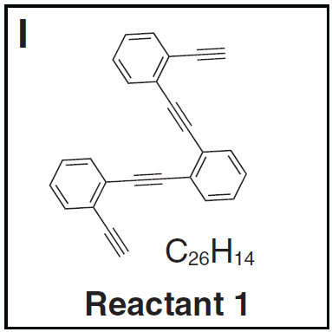
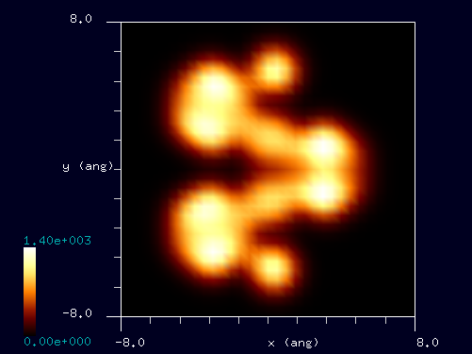
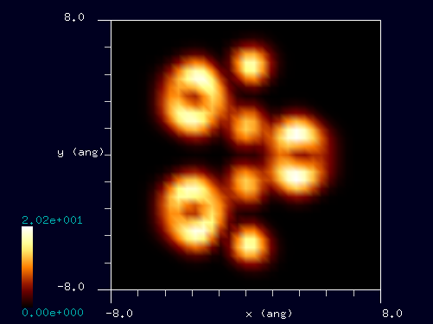
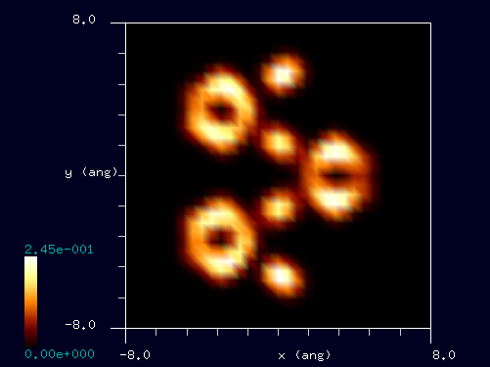
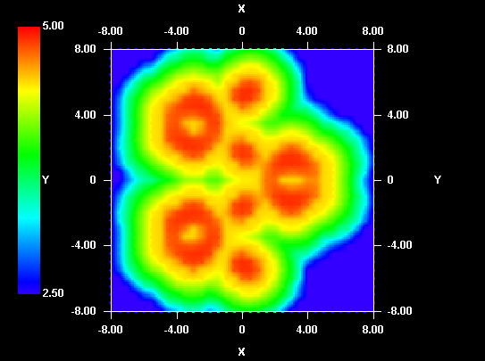

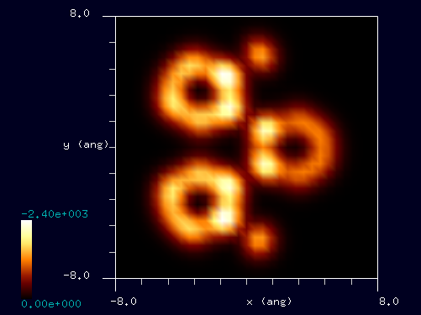

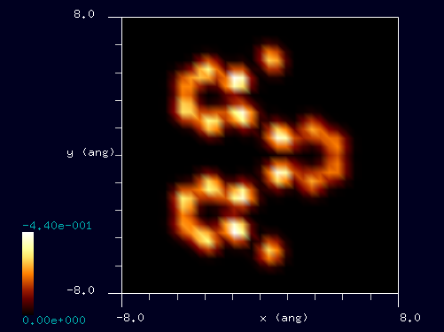
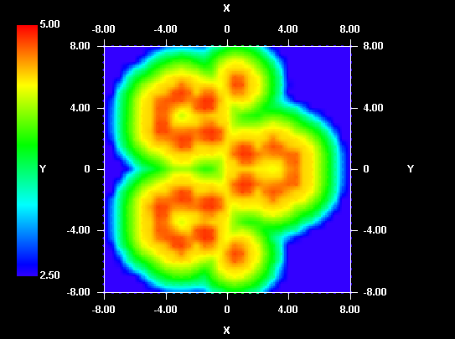
【DFTB】 炭化水素C₂₆H₁₄のSTMシミュレーション
cf. Experiment
C₂₆H₁₄, 1,2-bis[2-(2-ethynylphenyl)ethynyl]benzene
Constant current STM, I = 25 pA, V = 0.1 V
探針: CO
試料: C₂₆H₁₄ molecule
基板は無視
探針高さ: 2.5 – 5.0 Å
探針バイアス: +3.0 V and -3.0 V
D.G. Oteyza et al., Science 340, 1434-1437 (2013).
Tunneling current images and constant current STM images for positive and negative biases.
V_{tip} = +3.0 V
cc-STM for I = +0.05 nA
z_{tip} = 4.5 Å
z_{tip} = 4.0 Å
z_{tip} = 3.5 Å
V_{tip} = -3.0 V
cc-STM for I = -0.10 nA
z_{tip} = 4.5 Å
z_{tip} = 4.0 Å
z_{tip} = 3.5 Å
Notes:
DFTB_ConstHeightSTM_Organic_005a
DFTB_ConstHeightSTM_Organic_005b
DFTB_ConstHeightSTM_Organic_005c
DFTB_ConstHeightSTM_Organic_005d
DFTB_ConstHeightSTM_Organic_005e
DFTB_ConstHeightSTM_Organic_005f
DFTB_ConstCurrentSTM_Organic_002a
DFTB_ConstCurrentSTM_Organic_002b
1,2ビス2 2エチルフェニルエチニル ベンゼン. 基板のAg(001)は無視した。
計算した探針高さの範囲は2.5 – 5.0 A. トンネル電流像の電流値の単位はnA.
Dimas G de Oteyza, Patrick Gorman, Yen-Chia Chen, Sebastian Wickenburg, Alexander Riss, Duncan J. Mowbray, Science 340, 1434-1437 (2013).
1

