Slide 1
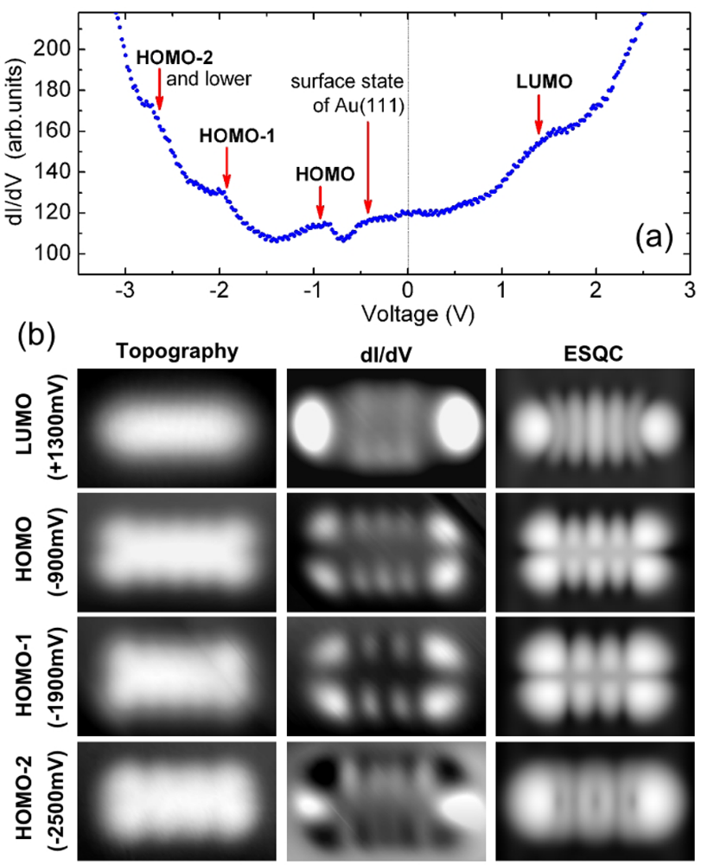
【DFTB】 Constant current STM image of pentacene
文献より、Pentacene on Au(111)のSTM topography像およびdI/dV像
実測
実測
理論計算
STM-elastic scattering quantum chemistry (ESQC)
分子軌道を使ったconstant current topography 計算。
探針効果を含めると実測像と一致する。
W.-H. Soe et al., PRL 102, 176102 (2009).
Notes:
(b) The left and center columns are experimental topographic images and dI/dV maps recorded at voltages indicated by the arrows in (a). Tunneling currents for the STM images and dI/dV maps are, from the top, 5 nA, 3 nA, 5 nA, and 6 nA. The right column displays the corresponding calculated STM-elastic scattering quantum chemistry (ESQC) images, at a constant tunneling current of 1 nA, for a pentacene molecule adsorbed on Au(111) at the monoelectronic energy resonances corresponding to the LUMO, HOMO, HOMO-1, and HOMO-2, respectively. All images are 2.5 nm x 1.5 nm.
1

Slide 2
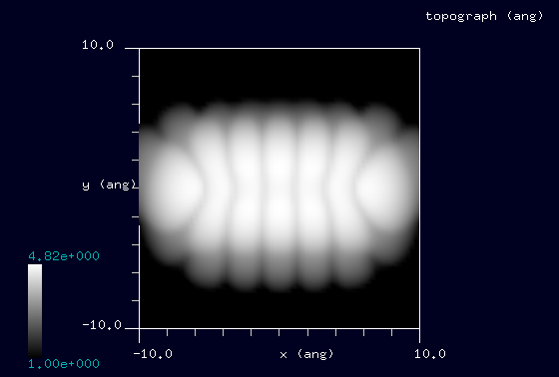
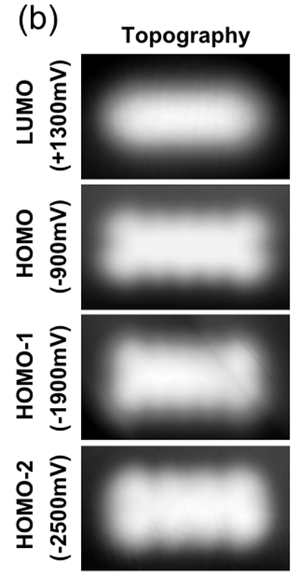
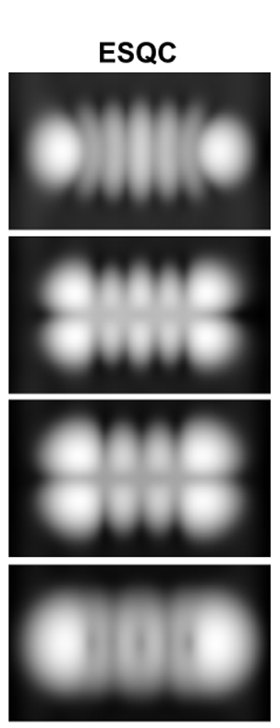

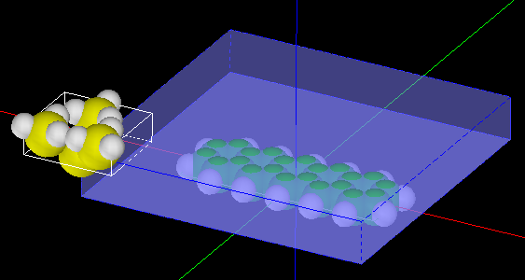
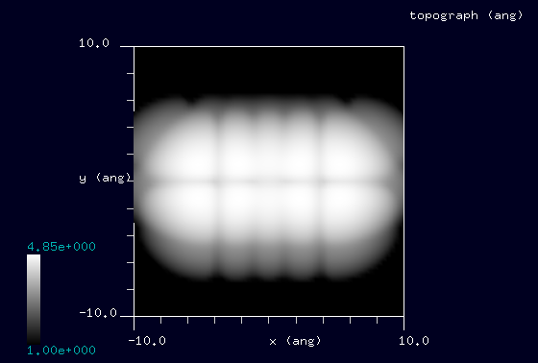

【DFTB】 Constant current STM image of pentacene
DFTB constant current topography
Ref. Pentacene on Au(111)
Experiment
Calculation
V_{tip}= -1.0 V
V_{tip}= +1.0 V
探針: Si₄H₉
試料: Pentacene molecule.
Without substrate.
Current = 5 nA
for all calculations
V_{tip}= +2.0 V
V_{tip}= +2.8 V
W.-H. Soe et al., PRL 102, 176102 (2009).
Notes:
DFTB_ConstCurrentSTM_Organic_003e
DFTB_ConstCurrentSTM_Organic_003f
DFTB_ConstCurrentSTM_Organic_003g
DFTB_ConstCurrentSTM_Organic_003h
2

