Slide 1
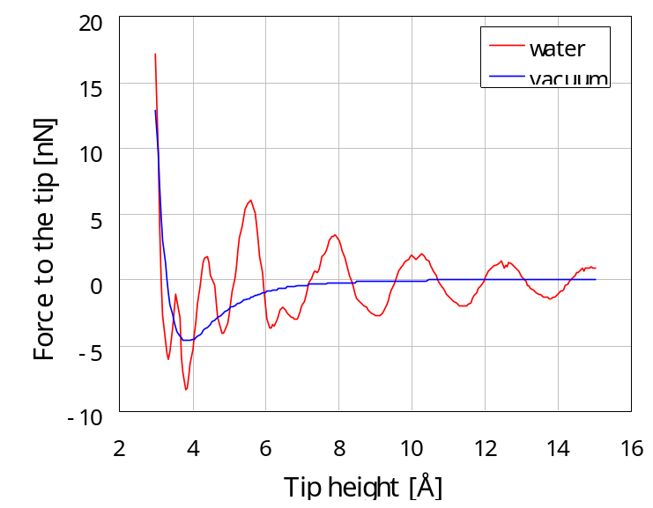
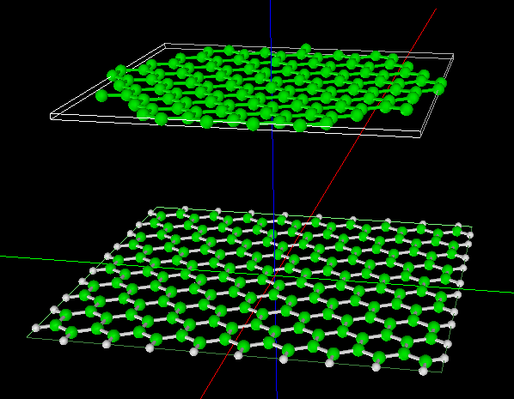
【CG-RISM】水中のフォースカーブシミュレーション
Simulated force curve
Tip: Bent graphene
Sample: Graphene sheet
Bent graphene approaches a graphene sheet in water
水中の場合、水和構造による振動的振舞いが現れる。
Notes:
CGRISM_ForceCurve_Inorganic_003

Slide 2
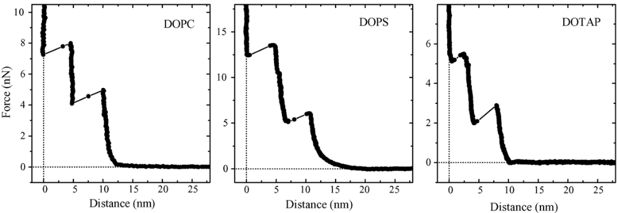
（参考）MICAのフォースカーブ
Fig. 36. Typical force-vs.-distance curve measured on a planar mica surface in buffer after exposure to 1,2-dioleoyl-sn-glycero-3-phosphocholine (DOPC), 1,2-dioleoyl-sn-glycero-3-phospho-L-serine (DOPS), and 1,2-dioleoyl-3-trimethylammonium-propanechloride (DOTAP) vesicles. The AFM tips were first coated with chromium and gold and then with a monolayer of mercapto undecanol (HS(CH2)11OH). For details see Ref. [738].
Hans-Ju¨rgen Butt et. al, Surface Science Reports 59 (2005) 1–152.
Force measurements with the atomic force microscope: Technique, interpretation and applications

